Slide 1
Welcome
CS 472/572
Unsupervised Machine Learning
Clustering 2
Week-3 -Class -2
Spring 2026
Instructor: Dr. Khondker Fariha Hossain

Slide 2
Inferring soft assignments with expectation maximization (EM)

Slide 3
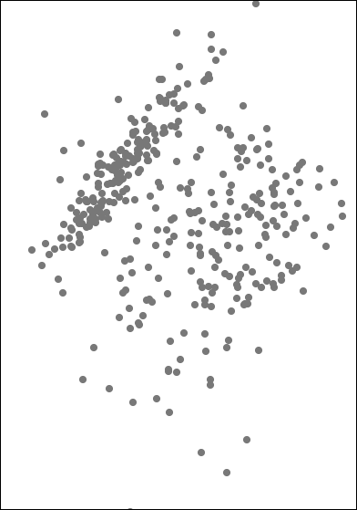
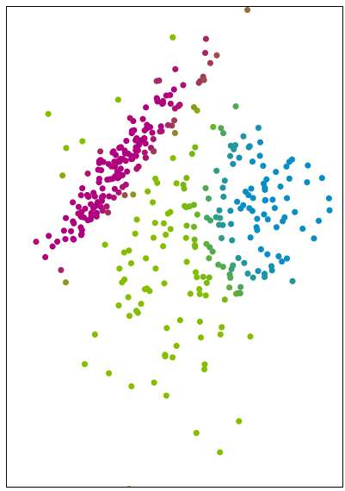
Inferring cluster labels
Data Desired soft assignments

Slide 4
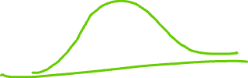



Part 1:
What if we knew the cluster parameters {π_{k} , μ_{k} , Σ_{k} }?

Slide 5
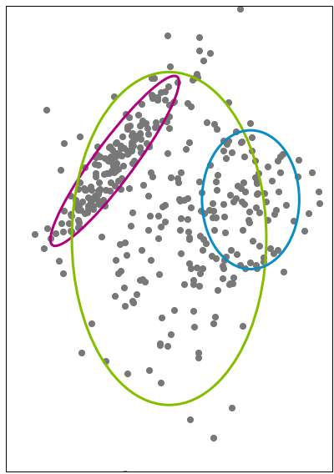












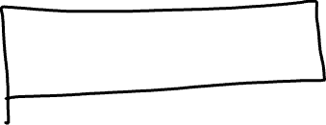
Compute responsibilities
Responsibility cluster k takes for observation i
r_{ik} = p(z_{i} = k | {⇡_{j}, µ_{j}, ⌃_{j}}^{K} , x_{i})
j=1
probability of assignment to cluster k
given model parameters and observed value

Slide 6































































































































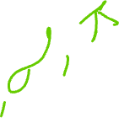
Responsibilities in pictures
Green cluster takes more responsibility
Blue cluster takes more responsibility
Uncertain… split responsibility

Slide 7















































Responsibilities in pictures
Need to weight by cluster probabilities, not just cluster shapes
Still uncertain,
but green cluster seems more probable…
takes more responsibility

Slide 8

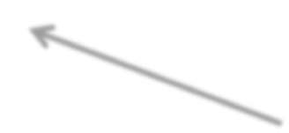


















































Responsibilities in equations
Responsibility cluster k takes for observation i
rik = ⇡k N (x_{i} | µ_{k}, ⌃_{k})
How likely is the observed value x_{i} under this cluster assignment?
Initial probability of being from cluster k

Slide 9


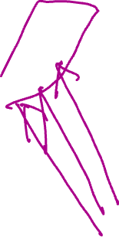

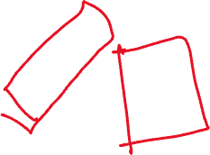
Responsibilities in equations
Responsibility cluster k takes for observation i
rik = ⇡k N (x_{i} | µ_{k}, ⌃_{k})
K
X
⇡_{j} N (x_{i} | µ_{j}, ⌃ )
j
Normalized over all possible cluster assignments
j=1

Slide 10
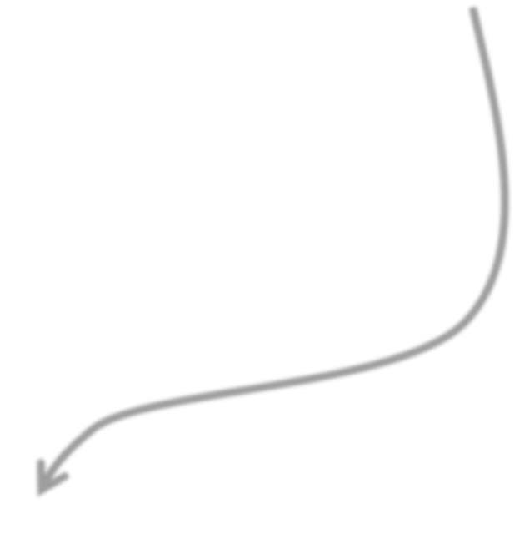


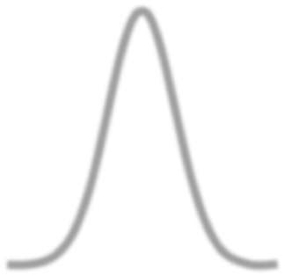

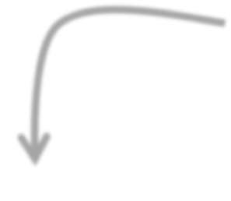


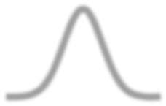



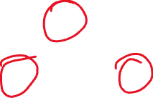



Recall: According to the model…
Without observing the image content, what’s the probability it’s from cluster k? (e.g., prob. of seeing “clouds” image)
p(z_{i} = k) = ⇡_{k}
Given observation x_{i} is from cluster k, what’s the likelihood of seeing x_{i}? (e.g., just look at distribution for “clouds”)
p(x_{i} | z_{i} = k, µ_{k}, ⌃_{k}) = N(x_{i}|µ_{k}, ⌃_{k})
π₁
π₂
π₃
x

Slide 11


Part 2a:
Imagine we knew the cluster (hard) assignments z_{i}

Slide 12
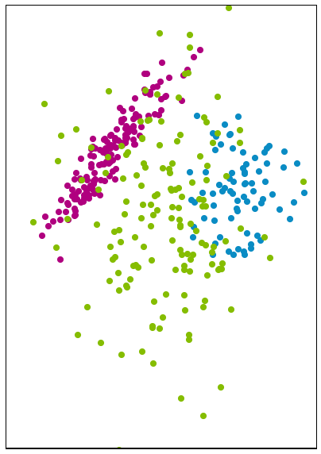
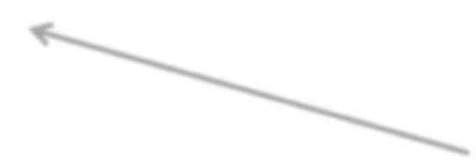


Estimating cluster parameters
Imagine we know the cluster assignments
Estimation problem decouples across clusters
Is green point informative of fuchsia cluster parameters?
NO!

Slide 13





Data table decoupling over clusters
R | G |  | B | Cluster
x₁[1] | x₁[2] |  | x₁[3] | 3
x₂[1] | x₂[2] |  | x₂[3] | 3
x₃[1] | x₃[2] |  | x₃[3] | 3
x₄[1] | x₄[2] |  | x₄[3] | 1
x₅[1] | x₅[2] |  | x₅[3] | 2
x₆[1] | x₆[2] |  | x₆[3] | 2
R
G
B
Cluster
x₁[1]
x₁[2]
x₁[3]
3
x₂[1]
x₂[2]
x₂[3]
3
R
G
B
Cluster
x₃[1]
x₃[2]
x₃[3]
3
R
x₄[1]
G
x₄[2]
B
Clu₁ster
x₄[3]
x₅[1]
x₅[2]
x₅[3]
2
x₆[1]
x₆[2]
x₆[3]
2

Slide 14



Maximum likelihood estimation
R | G | B | Cluster
x₁[1] | x₁[2] | x₁[3] | 3
x₂[1] | x₂[2] | x₂[3] | 3
x₃[1] | x₃[2] | x₃[3] | 3
Estimate {π_{k} , μ_{k} , Σ_{k} } given data assigned to cluster k
maximum likelihood estimation (MLE)
Find parameters that maximize the score, or likelihood, of data

Slide 15
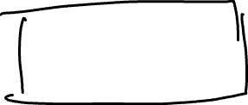


Mean/covariance MLE
R | G | B | Cluster
x₁[1] | x₁[2] | x₁[3] | 3
x₂[1] | x₂[2] | x₂[3] | 3
x₃[1] | x₃[2] | x₃[3] | 3
1
µˆ =
N_{k}
1
=
N_{k}
X
x
k
i
i in k
X
⌃ˆ
(x — µˆ_{k})(x_{i} — µˆ_{k})
T
k
i
i in k
Scalar case:

Slide 16







Cluster proportion MLE
R | G | B | Cluster
x₄[1] | x₄[2] | x₄[3] | 1
# obs in cluster k
R | G | B | Cluster
x₅[1] | x₅[2] | x₅[3] | 2
x₆[1] | x₆[2] | x₆[3] | 2
N_{k}
⇡ˆ =
k
N
R | G | B | Cluster
x₁[1] | x₁[2] | x₁[3] | 3
x₂[1] | x₂[2] | x₂[3] | 3
x₃[1] | x₃[2] | x₃[3] | 3
total # of obs
True for general mixtures of i.i.d. data, not just Gaussian clusters

Slide 17
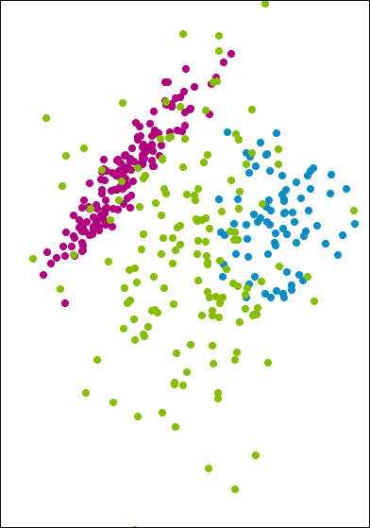


Part 2a summary
needed to compute soft assignments
Cluster parameters are simple to compute if we know the cluster assignments
But, we don’t know these!

Slide 18
Part 2b:
What can we do with just soft assignments r_{ij}?

Slide 19


Estimating cluster parameters from soft assignments
Instead of having a full observation x_{i} in cluster k, just allocate a portion r_{ik}
x_{i} divided across all clusters, as determined by r_{ik}

Slide 20


Maximum likelihood estimation from soft assignments
Just like in boosting with weighted observations…
R | G | B | ^{r}i1 | ^{r}i2 | ^{r}i3
x₁[1] | x₁[2] | x₁[3] | 0.30 | 0.18 | 0.52
x₂[1] | x₂[2] | x₂[3] | 0.01 | 0.26 | 0.73
x₃[1] | x₃[2] | x₃[3] | 0.002 | 0.008 | 0.99
x₄[1] | x₄[2] | x₄[3] | 0.75 | 0.10 | 0.15
x₅[1] | x₅[2] | x₅[3] | 0.05 | 0.93 | 0.02
x₆[1] | x₆[2] | x₆[3] | 0.13 | 0.86 | 0.01
52% chance this obs is in cluster 3
Total weight in cluster: (effective # of obs)
1.242 | 2.8 | 2.42

Slide 21
Maximum likelihood estimation from soft assignments
R | G | B | ^{r}i1 | ^{r}i2 |  | ^{r}i3
x₁[1] | x₁[2] | x₁[3] | 0.30 |  | 0.18 | 0.52
x₂[1] | x₂[2] | x₂[3] | 0.01 |  | 0.26 | 0.73
x₃[1] | x₃[2] | x₃[3] | 0.002 |  | 0.008 | 0.99
x₄[1] | x₄[2] | x₄[3] | 0.75 |  | 0.10 | 0.15
x₅[1] | x₅[2] | x₅[3] | 0.05 |  | 0.93 | 0.02
x₆[1] | x₆[2] | x₆[3] | 0.13 |  | 0.86 | 0.01
Cluster data weights
R
G
B
Cluster 1
weights
x₁[1]
x₁[2]
x₁[3]
0.30
x₂[1]
x₂[2]
x₂[3]
0.01
x₃[1]
x₃[2]
x₃[3]
0.002
x₄[1]
x₄[2]
x₄[3]
0.75
x₅[1]
x₅[2]
x₅[3]
0.05
x₆[1]
x₆[2]
x₆[3]
0.13

Slide 22
Maximum likelihood estimation from soft assignments
R G B
x₁[1] x₁[2] x₁[3]
Cluster 1 weights
0.30
x₂[1]
x₂[2]
x₃[2]
x₂[3]
x₃[3]
0.01
0.002
Cluster 2
R G
x₁[1] x₁[2]
B
weights
x [1]
3
x₄[1]
x₄[2]
x₄[3]
x₁[3]
0.18
0.75
x₅[1]
x₂[1]
x₂[2]
x₃[2]
x₂[3]
x₃[3]
0.26
0.00
Cluster 3 weights
x₅[2]
R
x₅[3]
G
0.05
B
x [1]
x₃[1]
8
6
x₆[2]
x₆[3]
0.13
x₄[1]
x₁[1]
x₁[2]
x₁[3]
0.52
x₄[2]
x₄[3]
0.10
x₅[1]
x₂[1]
x₂[2]
x₂[3]
0.73
x₅[2]
x₅[3]
0.93
x₆[1]
x₃[1]
x₃[2]
x₃[3]
0.99
x₆[2]
x₆[3]
0.86
x₄[1]
x₄[2]
x₄[3]
0.15
x₅[1]
x₅[2]
x₅[3]
0.02
x₆[1]
x₆[2]
x₆[3]
0.01

Slide 23





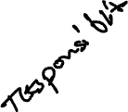

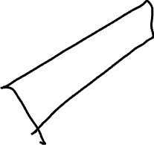
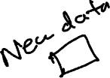



Cluster-specific location/shape MLE
R | G | B | Cluster 1 weights
x₁[1] | x₁[2] | x₁[3] | 0.30
x₂[1] | x₂[2] | x₂[3] | 0.01
x₃[1] | x₃[2] | x₃[3] | 0.002
x₄[1] | x₄[2] | x₄[3] | 0.75
x₅[1] | x₅[2] | x₅[3] | 0.05
x₆[1] | x₆[2] | x₆[3] | 0.13
N
1
X
µˆ =
r x
k
_{N} soft
ik i
k
i=1
N
1
X
⌃ˆ
=
r (x_{i} — µˆ_{k})(x_{i} — µˆ_{k})^{T}
k
_{N} soft
ik
k
i=1
N
X
N
soft
k
= r
ik
Compute cluster parameter estimates with weights on each row operation
i=1
Total weight in cluster k
= effective # obs

Slide 24




MLE of cluster proportions ⇡ˆ_{k}
^{r}i1 | ^{r}i2 | ^{r}i3
0.30 | 0.18 | 0.52
0.01 | 0.26 | 0.73
0.002 | 0.008 | 0.99
0.75 | 0.10 | 0.15
0.05 | 0.93 | 0.02
0.13 | 0.86 | 0.01
_{N} soft
⇡ˆ_{k} = ^{k}
N
N
X
N
soft
k
= r
ik
Estimate cluster proportions from relative weights
i=1
Total weight in cluster k
= effective # obs
Total weight in cluster:
Total weight in dataset:
1.242 | 2.8 | 2.42
6
# datapoints N

Slide 25

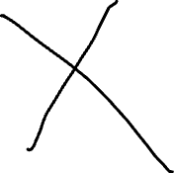
Defaults to hard assignment case when r_{ij} in {0,1}
Hard assignments have:
⇢
1 i in k
0 otherwise
r =
ik
R | G | B | ^{r}i1 | ^{r}i2 | ^{r}i3
x₁[1] | x₁[2] | x₁[3] | 0 | 0 | 1
x₂[1] | x₂[2] | x₂[3] | 0 | 0 | 1
x₃[1] | x₃[2] | x₃[3] | 0 | 0 | 1
x₄[1] | x₄[2] | x₄[3] | 1 | 0 | 0
x₅[1] | x₅[2] | x₅[3] | 0 | 1 | 0
x₆[1] | x₆[2] | x₆[3] | 0 | 1 | 0
One-hot encoding of cluster assignment
Total weight in cluster:
1 | 2 | 3

Slide 26





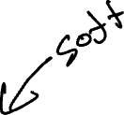
Equating the estimates…
N
_{N} soft
X
₌ k
N
soft
k
= r
⇡ˆ
ik
k
N
1
i=1
N
X
µˆ =
r x
k
_{N} soft
ik i
k
i=1
N
1
X
⌃ˆ
=
r (x_{i} — µˆ_{k})(x_{i} — µˆ_{k})^{T}
k
_{N} soft
ik
k
i=1

Slide 27
Part 2b summary
Still straightforward to compute cluster parameter estimates
from soft assignments

Slide 28
Expectation maximization (EM)

Slide 29
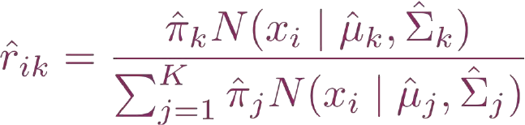

Expectation maximization (EM): An iterative algorithm
Motivates an iterative algorithm:
E-step: estimate cluster responsibilities given current parameter estimates
M-step: maximize likelihood over parameters given current responsibilities

Slide 30
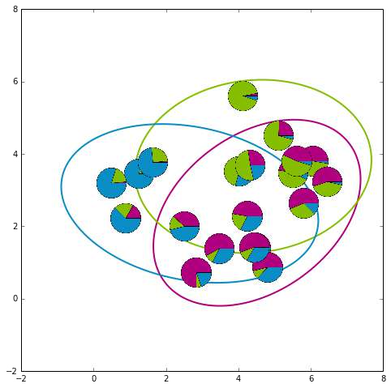
EM for mixtures of Gaussians in pictures – initialization

Slide 31



EM for mixtures of Gaussians in pictures – after 1st iteration

Slide 32
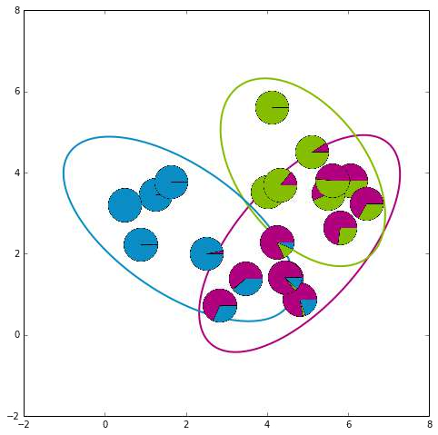
EM for mixtures of Gaussians in pictures – after 2nd iteration

Slide 33
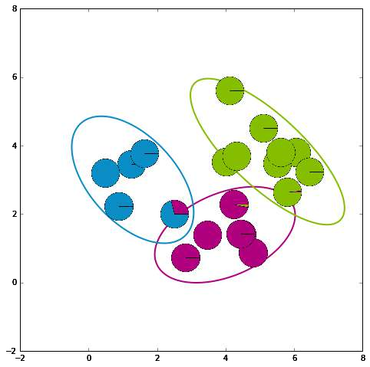



EM for mixtures of Gaussians in pictures – converged solution

Slide 34
The nitty gritty of EM

Slide 35
Convergence of EM
EM is a coordinate-ascent algorithm
- Can equate E-and M-steps with alternating maximizations of an objective function
Convergences to a local mode
We will assess via (log) likelihood of data under current parameter and responsibility estimates

Slide 36
Initialization
Many ways to initialize the EM algorithm
Important for convergence rates and quality of local mode found
Examples:
Choose K observations at random to define K “centroids”. Assign other observations to nearest centriod to form initial parameter estimates.
Pick centers sequentially to provide good coverage of data like in k-means++
Initialize from k-means solution
Grow mixture model by splitting (and sometimes removing) clusters until K clusters are formed

Slide 37



































Overfitting of MLE
Maximizing likelihood can overfit to data
Imagine at K=2 example with one obs assigned to cluster 1 and others assigned to cluster 2
- What parameter values maximize likelihood?
Set center equal to point and shrink variance to 0
Likelihood goes to ∞ !

Slide 38
Overfitting in high dims
Doc-clustering example:
Imagine only 1 doc assigned to cluster k has word w (or all docs in cluster agree on count of word w)
Likelihood maximized by setting µ [w] = x [w] and σ² = 0
k i w,k
Likelihood of any doc with different count on word w being in cluster k is 0!

Slide 39
Simple regularization of M-step for mixtures of Gaussians
Simple fix: Don’t let variances → 0!
Add small amount to diagonal of covariance estimate
Alternatively, take Bayesian approach and place prior on parameters.
Similar idea, but all parameter estimates are “smoothed” via cluster pseudo-observations.

Slide 40




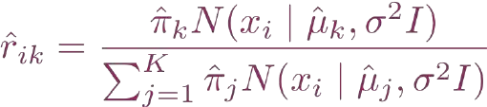
Relationship to k-means
Consider Gaussian mixture model with
Spherically
- Spherical clusters with equal variances, so relative likelihoods just function of distance to cluster center
_{σ}2
symmetric clusters
_{σ}2
_{σ}2
Σ =
- As variances→0, likelihood ratio becomes 0 or 1
_{σ}2
- Responsibilities weigh in cluster proportions, but dominated by likelihood disparity
and let the variance parameter σ → 0
Datapoint gets fully assigned to nearest center, just as in k-means

Slide 41
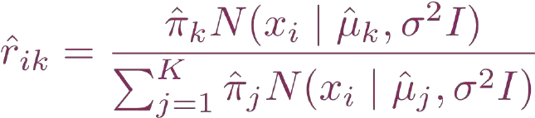






Infinitesimally small variance EM
= k-means
1. E-step: estimate cluster responsibilities given current parameter estimates
Decision based on distance to nearest cluster center
Infinitesimally small
2. M-step: maximize likelihood over parameters given current responsibilities (hard assignments!)

Slide 42
Let’s Work…
Colab Notebook
https://colab.research.google.com/drive/1pCQL-fimmm7SvALHyv4LdwEb9NLNKHOY?usp=sharing
Download it first then upload in colab platform

Slide 43
Thank you
This content includes adaptations from instructional materials originally created by Emily Fox and Carlos Guestrin for the University of Washington’s Machine Learning Specialization on Coursera. All rights reserved by the original authors.

